Slide 1

Music Genre Classification using Audio Dataset
Final Project Presentation On
Presented By
Nitin Sharma
Tarushi Jat
Under Supervision of
Dr. Anand Kumar M

Slide 2
ABSTRACT
GOAL is to develop a deep learning model that can classify audio music files into different genres using their frequency spectrum..
As an output our model will classify an input audio file into one of the following 10 genres : Blues, Classical, Country, Disco, Hip-Hop, Jazz, Metal, Pop, Reggae and Rock.
Widely used by in field of music recommendation which plays an important role tying up customers. Eg : Spotify and Shazam

Slide 3


DATASET AND WORKING ENVIRONMENT
Network Intrusion Dataset
System Setup
Google colab environment
Network Intrusion Dataset from OCSLAB
Language : Python
File Format : pcap
Total Audio Files : 1000
Audio Files per genre : 100
Length of each audio file : 30s
Total Genre : 10
TrainData : TestData :: 80 : 20
Genres : Blues, Classical, Country, Disco, Hip-Hop, Jazz, Metal, Pop, Reggae and Rock

Slide 4
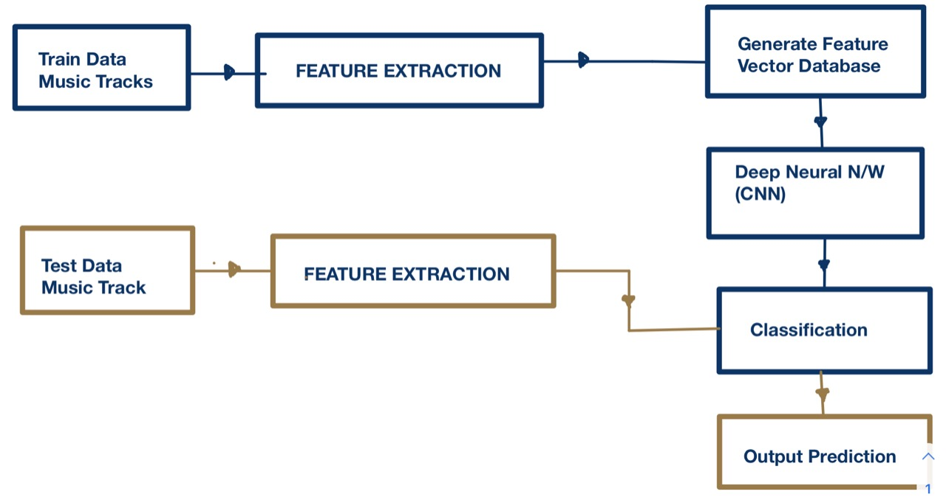
WORKFLOW

Slide 5
WORKFLOW : STEPS
Understanding Audio Signal
Feature Extraction Build Up
Feature Extraction
Pre-Processing on Data
CNN Model : Performance Tuning
Accuracy Comparison With Base Paper
Future Work

Slide 6
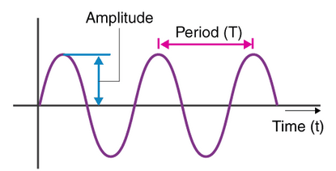
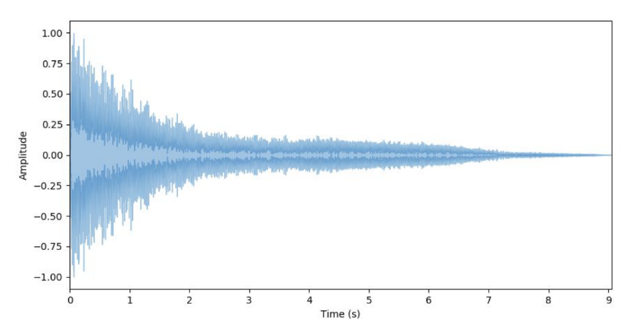
Understanding Audio Signal
Audio Signal
A signal is a variation of a certain quantity over time. In case of audio, this is air pressure.
Oscillation of medium molecules due to vibration of object results in alteration in air pressure which in return creates waves.
Representation
Waves can be represented using waveform that is basically viewed as a function of amplitude over time.

Slide 7
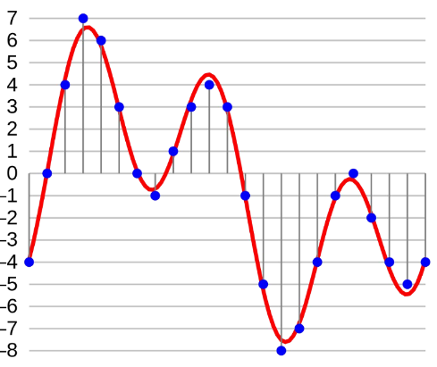
Understanding Audio Signal
Storing Waveform
Waveforms are analog and cannot be stored and hence we need to convert them into digital signal.
Digitalization is governed by two factors : Sampling factor and Quantization.
Sampling Factor : No. of sample per second to consider.
Quantization : Amplitude of samples are quantized to closest integer.
Higher sampling rate means that more data will be collected and hence we will get audio of high quality but will result in requiring more computation power.

Slide 8
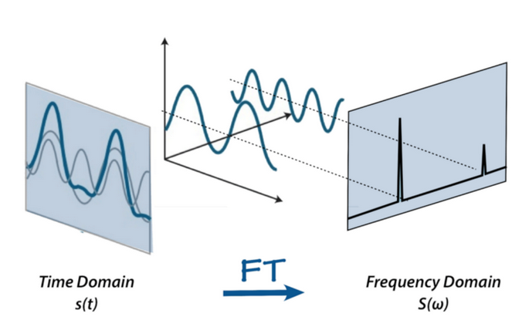
Feature Extraction : Build Up
Fourier Transform
An audio signal is comprised of several single-frequency sound waves.
FT converts the signal from the time domain into the frequency domain. The result is called a power spectrum.
Problem with Fourier Transform
Audio data is time series and after doing FT we loose time element of audio signal.

Slide 9
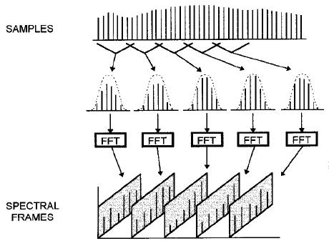
Feature Extraction : Build Up
Short Term Fourier Transform
Computes different FT at different time
Information about time is preserved.
Frame Size in STFT signifies different interval at which we are to perform FT again.
As a result of STFT, we get a spectrogram which gives us information about magnitude as a function of frequency and time.
Songs that sound drastically different, results in drastically different spectrograms.

Slide 10
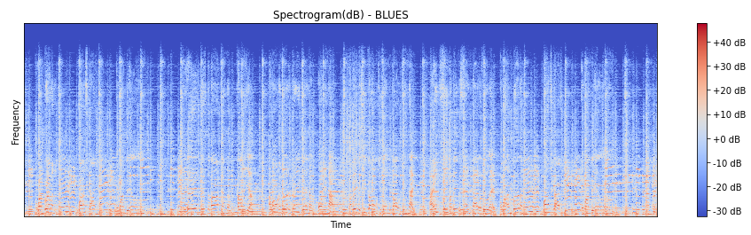
Feature Extraction : Build Up
DATA REPRESENTATION

Slide 11
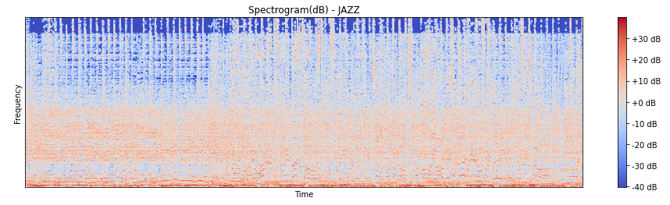
Feature Extraction : Build Up
DATA REPRESENTATION

Slide 12
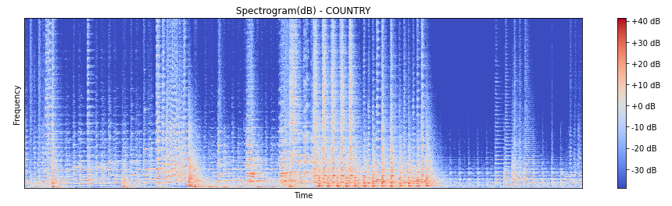
Feature Extraction : Build Up
DATA REPRESENTATION

Slide 13
Feature Extraction
Deep Learning Pre-processing pipeline :
Step 1) Generate Audio Signal from audio dataset
Step 2) Generate spectrogram out of audio signal after performing short term fourier transform.
Step 3) Extract features from spectrogram and feed them to our neural network model.
….other steps
In case of DL, we focus on Mel Frequency Cepstral Coefficients (MFCC)
A mel spectrogram is a spectrogram where the frequencies are converted to the mel scale.
It is a frequency domain feature and hence is needed to be applied on each and every frame while performing stft.
We will be considering 13 different coefficient per reading as it is default for audio data.
Applications of MFCC involve Speech recognition, Musical Genre Classification, Music instrument classification, etc.

Slide 14
Pre-processing of Data
We have a 30 sec long file which was divided into 3 sec data points to increase total amount of data.
Total 10 segments per file were considered.
Total 66150 samples per segment were captured at a sample rate of 22050 amplitude samples for second.
These samples were divided across fragments for further preprocessing.
Sliding window for FFT was considered to be 512 and 2048 samples per frame was considered.
13 coefficients per frames were extracted to make one single input point.

Slide 15
CNN Model : Performance Tuning
We tried manually tuning our parameters and tried to achieve better accuracies
Some of those readings are shared in further and in upcoming slides.
Number of output classes are 10 as there are 10 musical genre in which are input is needed to be classified
Dense, Flatten and output layers are same for all and we experimented around with convolution layer.
Dense Layer : Dense(64); Activation(ReLu); Dropout(0.1)
Output Layer: Number of output class = 10; Activation(SoftMax)

Slide 16
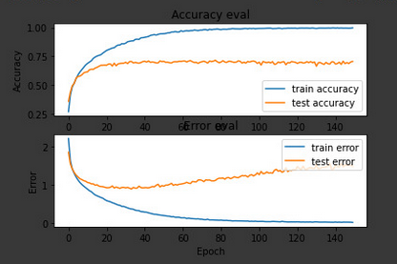
CNN Model : Performance Tuning
Convolution Layer Details | Accuracy
32 filters(3X3), Activation(ReLu); MaxPooling(3,3), Strides(2,2), input shape (1, 130, 13, 1) 32 filters(3X3), Activation(ReLu); MaxPooling(3,3), Strides(2,2) 32 filters(2X2), Activation(ReLu); MaxPooling(2,2), Strides(2X2) Epoch : 150, Batch : 32, Rate : 0.001 | Training Accuracy : 99.65% Testing Accuracy : 69.02
Here we can clearly see that our model is overfitting as train and test accuracy are varying very highly. Hence we need to take help of Regularization to improve our result

Slide 17
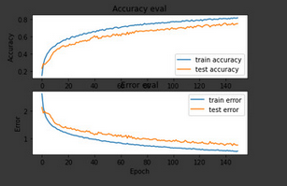
CNN Model : Performance Tuning
Convolution Layer Details | Accuracy
32 filters(3X3), Activation(ReLu); MaxPooling(3,3), Strides(2,2), L1 = 0.01 input shape (1, 130, 13, 1) 32 filters(3X3), Activation(ReLu); MaxPooling(3,3), Strides(2,2) L1 = 0.01 32 filters(2X2), Activation(ReLu); MaxPooling(2,2), Strides(2X2), L1 = 0.01 Epoch : 150, Batch : 64, Rate : 0.001 | Training Accuracy : 80% Validation Accuracy : 74.91% Testing Accuracy : 74.52

Slide 18
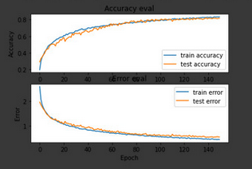
CNN Model : Performance Tuning
Convolution Layer Details | Accuracy
32 filters(3X3), Activation(ReLu); MaxPooling(3,3), Strides(2,2), input shape (1, 130, 13, 1) Dropout(0.3) 32 filters(3X3), Activation(ReLu); MaxPooling(3,3), Strides(2,2) Dropout(0.3) 32 filters(2X2), Activation(ReLu); MaxPooling(2,2), Strides(2X2) Dropout(0.3) Epoch : 150, Batch : 32, Rate : 0.001 | Training Accuracy : 83.59% Validation Accuracy : 81.48% Testing Accuracy : 79.87%

Slide 19
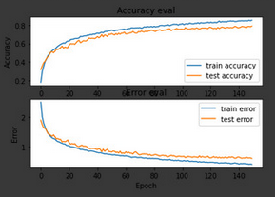
CNN Model : Performance Tuning
Convolution Layer Details | Accuracy
32 filters(3X3), Activation(ReLu); MaxPooling(3,3), Strides(2,2), Dropout(0.2), input shape (1, 130, 13, 1) 32 filters(3X3), Activation(ReLu); MaxPooling(3,3), Strides(2,2) Dropout(0.2) 32 filters(2X2), Activation(ReLu); MaxPooling(2,2), Strides(2X2) Dropout(0.1) Batch 32, Epochs : 150, rate : 0.001 | Training Accuracy : 85.9% Validation Accuracy: 78.91% Testing Accuracy : 80.63%

Slide 20
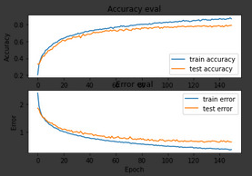
CNN Model : Performance Tuning : BEST
Convolution Layer Details | Accuracy
32 filters(3X3), Activation(ReLu); MaxPooling(3,3), Strides(2,2), Dropout(0.3), input shape (1, 130, 13, 1) 32 filters(3X3), Activation(ReLu); MaxPooling(3,3), Strides(2,2) Dropout(0.1) 32 filters(2X2), Activation(ReLu); MaxPooling(2,2), Strides(2X2) Dropout(0.1) Batch 32, Epochs : 150, rate : 0.0001 | Training Accuracy : 85.91% Validation Accuracy : 78.79% Testing Accuracy : 81.3%

Slide 21
Performance Comparison
Work By | Accuracy
Our Work Dataset : GTZAN | 81.30%
Vishnupriya S and K Meenakshi[2018] work using CNN Dataset : MSD Dataset (Bigger version of GTZAN) | 76.00%

Slide 22
Future Work
Creating other Deep learning based models and try to achieve higher accuracies.
Use the largest dataset that like Free Music Archive which offers (106,000 tracks with labeled genres)
Only predict the genre over the whole song and compare the accuracy to our results (should be higher).
Extend this work to musical notes classification.

Slide 23
References
Cook and Tzanetakis’s GTZAN dataset : https://www.kaggle.com/andradaolteanu/gtzan-dataset-music-genre-classification
Vishnupriya S and K Meenakshi[2018] work using CNN : https://ieeexplore.ieee.org/document/8441340
Beici Liang and Minwei Gu[2020] work using Transfer Learning : https://ieeexplore.ieee.org/abstract/document/9175547
Towards datascience blog on Musical Genre Classification : https://towardsdatascience.com/music-genre-classification-with-python-c714d032f0d8

Slide 24
THANK YOU!!!

